Slide 1
Drone Surveillance
Determining Ideal Fleet Size
Jane Blore
Stephan Boettcher
Andrew Keith
Mark Soreco
Notes:
DONE

Slide 2
Background
Presenter
Notes:
Need headline slide

Slide 3
Domestic Drone Surveillance
Stationary objects only, hostage situations
FBI reports around a dozen instances as of June 2013
PUMA approved in 2013 to monitor wildlife and oil spills
Scan Eagle, also 2013, monitor ice floes and whales
International Drone Surveillance
Used heavily in recent conflicts
Snowden leaks rumor NSA usage for targeted surveillance
United Nations monitor border violence in Congo
Dynamic movement of targets
Notes:
DONE

Slide 4
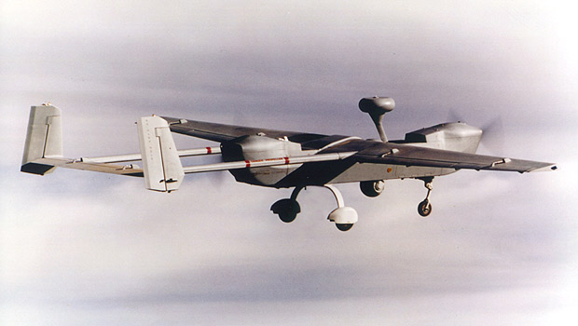
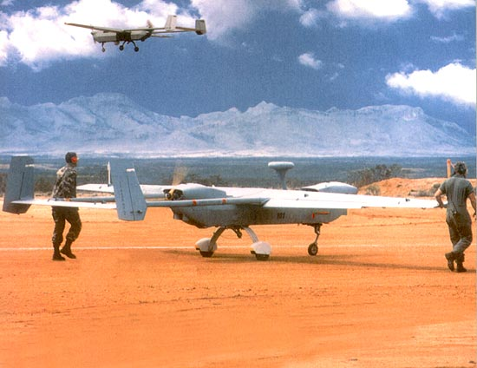
Hunter RQ-5
Images from www.army-technology.com
Notes:
DONE

Slide 5
Problem Statement
Presenter

Slide 6
Drones are widely used for intelligence gathering
Great deal of possible variation
Environment: Urban, Rural, Size, Climate
Aircraft: hand carried, runway constraint, flight times
Tasking: frequency, desired satisfaction
Targets: areas, individuals, static, dynamic
How many drones are required?
What is the most effective way to employ them?
Notes:
DONE

Slide 7
Assumptions
Presenter

Slide 8
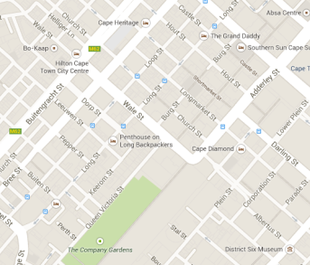
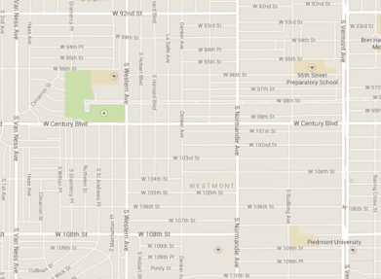
Grid like structure of LA, Kabul, Bagdad, Chicago, Cape Town, Toronto
There are two types of targets: people and vehicles
All targets are dynamic with some static tendencies
Intelligence establishes target list before simulation start, no preemption of targets
Drone instantaneously and autonomously id targets
Only drone used is Hunter RQ-5, nearby runways
Drones cannot communicate directly
Notes:
DONE

Slide 9
Conceptual Model
Presenter

Slide 10
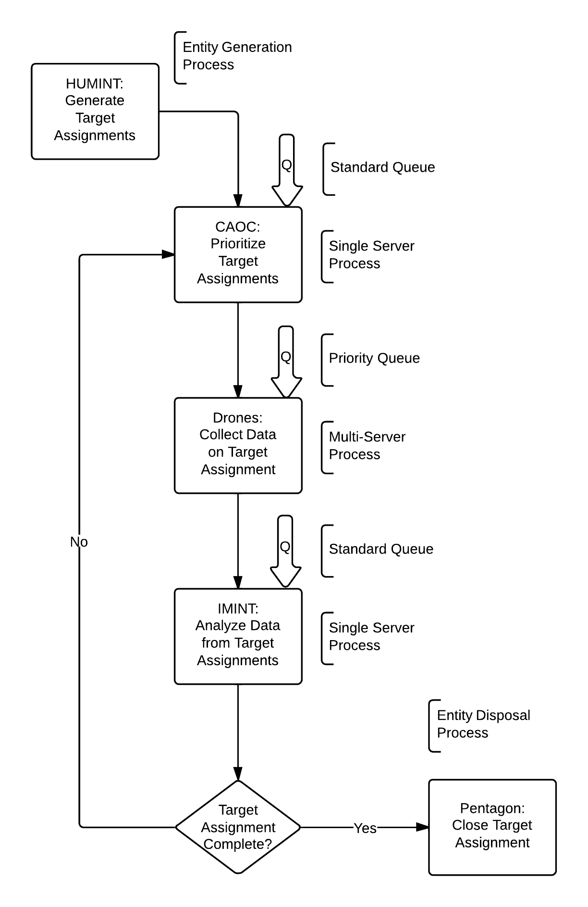
Process Overview
Notes:
DONE

Slide 11
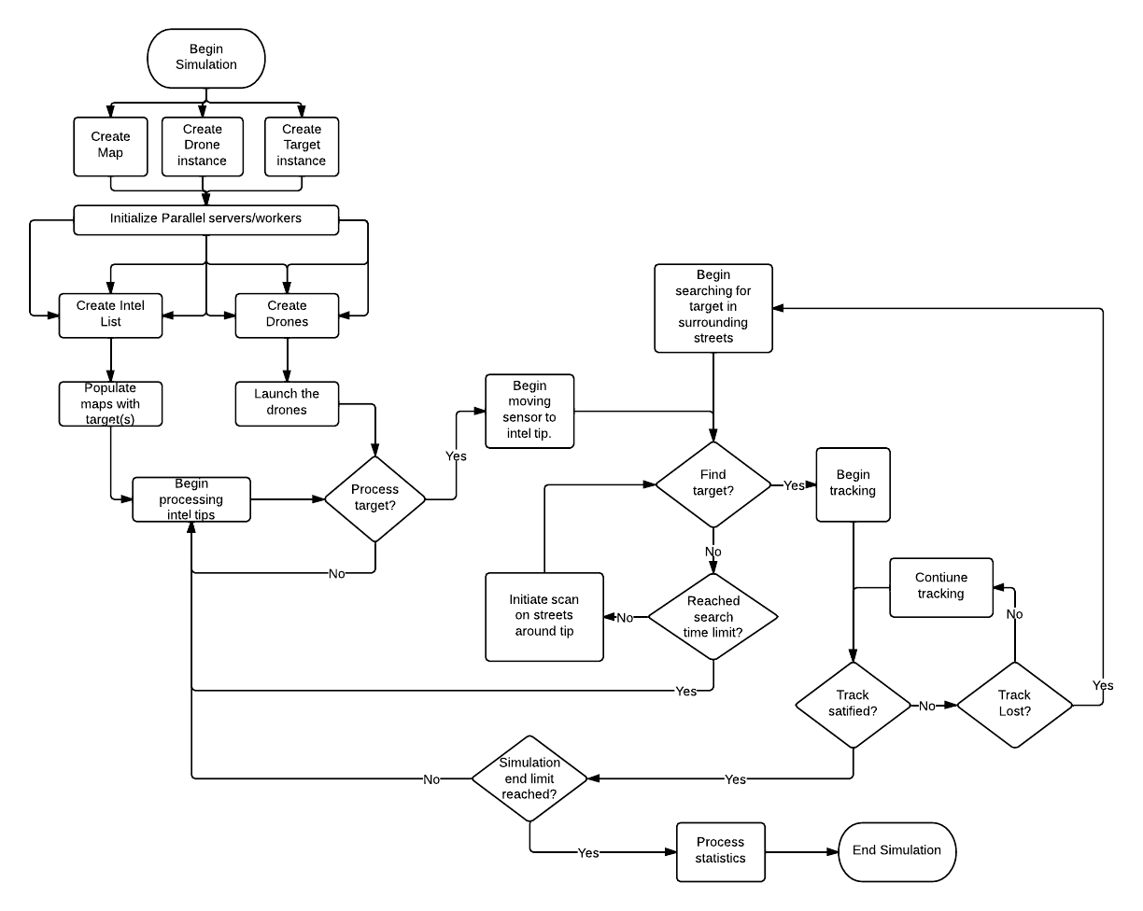
Program Logic Flow
Notes:
DONE

Slide 12
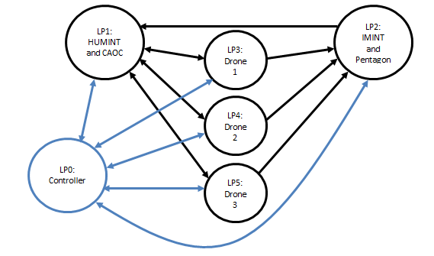
Logical Process Architecture
Notes:
Graphic needs updating

Slide 13
Messages
Type 1 Messages – Maintenance Messages
Type 2 Messages – Target Information
Type 3 Messages
Notes:
Needs work from Andrew

Slide 14
Data Collection
Presenter

Slide 15
Most of our data is historical or published data
Based on opinion and industry standards
Relying on unclassified and declassified published info
Examples
CIA standards for reliability of intelligence:
Probable events have at least 60% chance of occurring
Hunter RQ-5 technical specifications:
21 hrs MTBF
3 hrs MTTR
Top speed 54.44 m/s, Loiter 45.83 m/s
Vehicle Speeds
Based on standard urban speed limits for 25+ countries
TriDist(min = 11.11 m/s, mode = 19.44m/s, max = 15.28 m/s)
Notes:
DONE

Slide 16
Tracking Heuristics
Presenter

Slide 17
Heuristic 1: Naïve
Target Assignments are made strictly in priority order
No limit on search time for a target
If contact is lost, the same drone will reacquire the same target
No limit on the number of re-attempts
We expected that this heuristic would take the longest
Long idle travel times possible
Long search times expected
May re-attempt an extremely difficult target indefinitely
Bottom-line: Expected a poor result from this simplistic heuristic
Notes:
DONE

Slide 18
Heuristic 2: Local
Highest priority target are assigned to nearest idle drone
Drone will only search the local area
Previously attempted targets reenter queue at lower priority
No limit on the number of re-attempts
We expected this heuristic to be more efficient in simulation time, but less so in computational time
Drones spend more time tracking then searching
High number of messages due to reprioritizing targets
May give up too easily on medium range targets
Bottom-line: Expected a better result that the Naïve Heuristic
Notes:
DONE

Slide 19
Heuristic 3: Impatient
Distance is taken into account for target assignments
High priority targets are assigned first
Limited time is allowed for drones to acquire and track
Higher priority targets have longer allowable time
If targets are not complete, they will be reprioritized
We expected this heuristic to be most efficient in simulation time and moderately efficient computationally
Drones can search entire area but only for limited time
Some increase in messaging due to reprioritizing targets
Bottom-line: Expected a better result that the Naïve and Local Heuristics in terms of overall statisfication
Notes:
DONE

Slide 20
Verification and Validation
Presenter

Slide 21
Map
Picture
And description of what was done
Notes:
Steve

Slide 22
Message Passing
Picture
And description of what was done
Notes:
Mark

Slide 23
Drone Target Tracking
Picture
And description of what was done
Notes:
Steve or Andrew

Slide 24
Heuristics
Picture
And description of what was done
Notes:
Andrew

Slide 25
Testing Methodology
Presenter

Slide 26
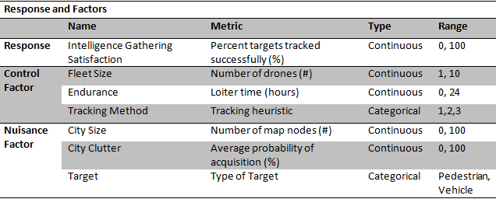
Factors Evaluated
Notes:
DONE

Slide 27
Sequential Testing Plan
L18 Screening Design
Custom Response Surface
198 Runs
All main factors characterized
Some interaction effects characterized
48 Runs
More detailed information regarding continuous factors
Initial Screening and Information Gathering
Further Testing for Rough Optimization
Notes:
DONE

Slide 28
Challenges
Presenter

Slide 29
Scope
Eliminated some factors: drone type, field of view, luminosity
Global Variable Time
Few rollbacks but potential exists due to duplicate tracking and reassignments
Messages
Consistent formatting, pulling the correct information
Queues
Empty queues caused continual loops in LPs
Notes:
DONE

Slide 30
Results and Analysis
Presenter

Slide 31
Insignificant Factors
Factor 1
Significant Factors
Factor 2
Insert table of factors and coefficients
Notes:
Still waiting on info

Slide 32
Conclusions
Presenter
Notes:
Still waiting on info

Slide 33
Possible Further Research
Presenter

Slide 34
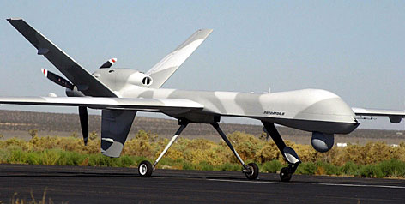
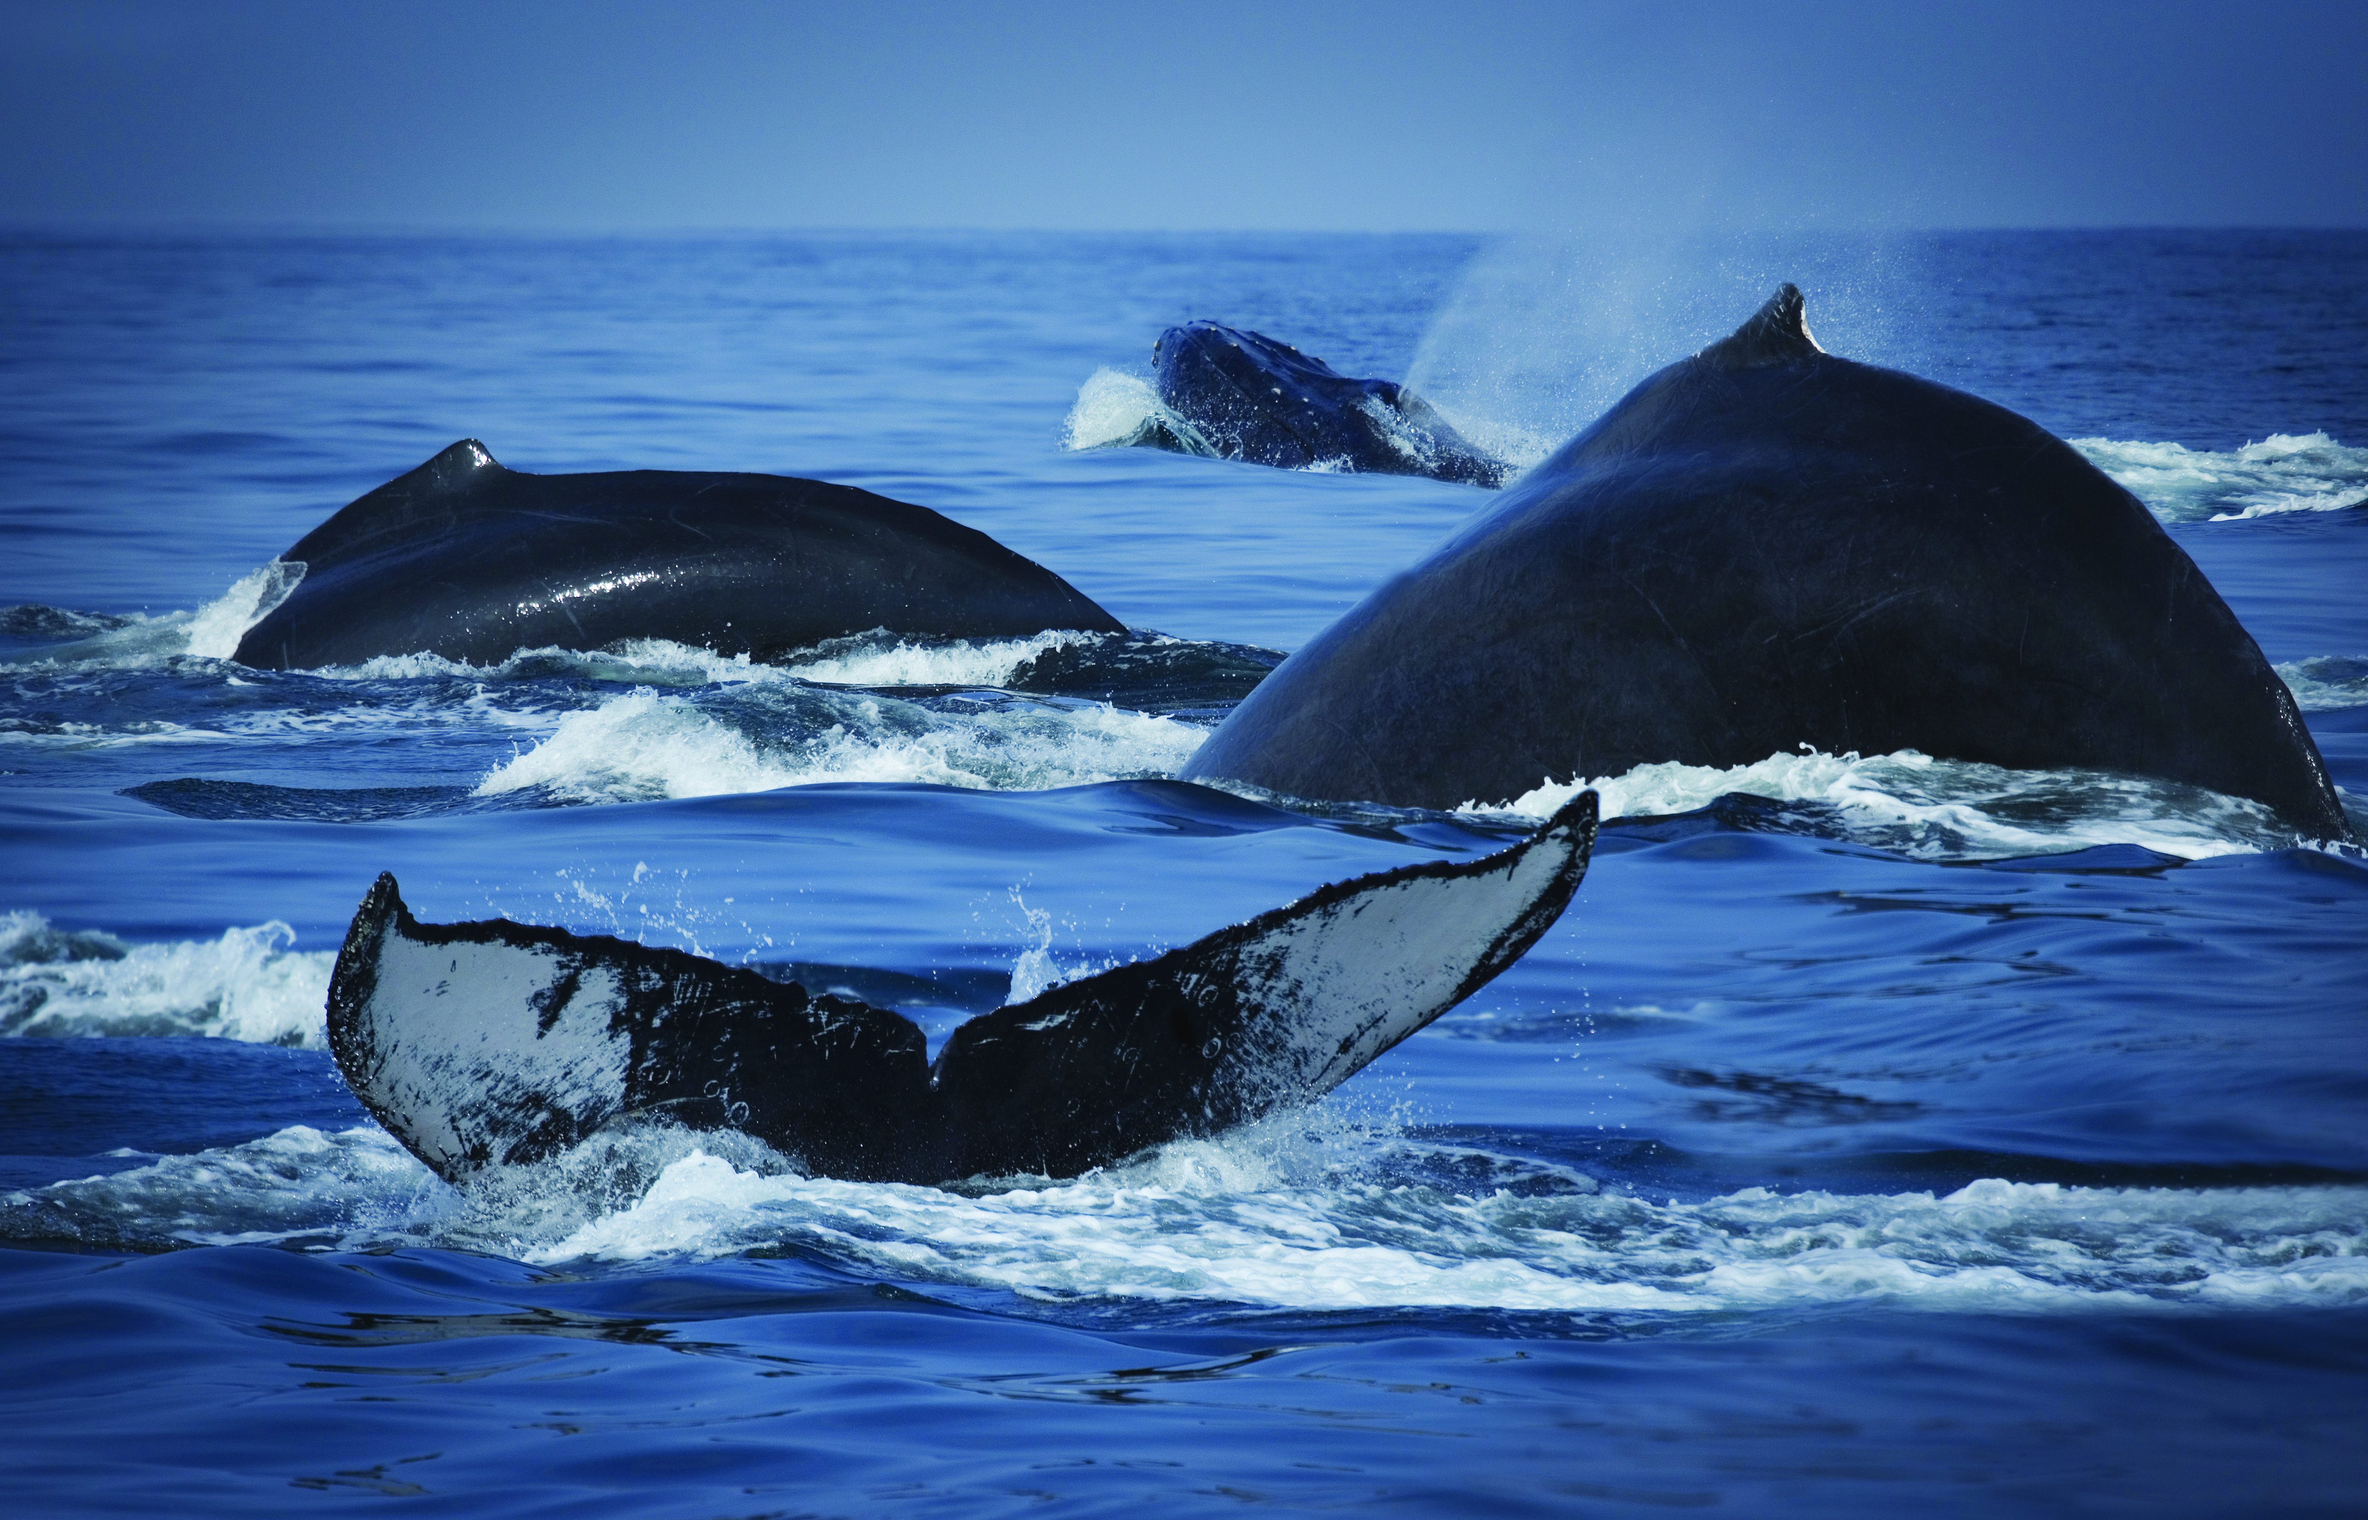
www.usatoday.com
Incorporation of Additional Drone Aircraft Types
Privacy Issues and Associated Litigation or Regulation
Cost Benefit Analysis of Fleets
Larger Target Variety: caravans, boarders, wildlife
Targeting Actions and Incorporation of Weapons
www.apftp.us
Notes:
DONE

Slide 35
Questions?

